Slide 2
MUNICIPAL CLEANING MANAGEMENT MOBILE BASED SYSTEM

Slide 3
OUTLINE
Introduction
Literature review
Methodology
Data collection
Requirement and system analysis
Project scenario
System actors
Use case diagram
Data base design
Project budget
Project scheduling

Slide 4
INTRODUCTION
What is Municipality?
Refers to a village, town, or city that’s usually governed by mayor and council.
This can be a corporate and political entity organized by residents of the area to operate within a prescribed geographic area for the purpose of providing public services.

Slide 5
Continue…
Municipal council functions include: -
Provision of state-run home services and basic unmet needs.
Organization of economical and environmental development
Construction of facilities required for municipal progress.
Social and cultural improvement of their inhabitants.

Slide 6
Continue…
Among of Problems face municipalities are:-
presence of waste in cities
Resource scarcity
Poor residence arrangement
Poor provision of health and education services
Poor infrastructure

Slide 7
PRESENCE OF WASTE AND GABARGE IN MUNICIPALITY
And where garbage/waste coming from?
Causes
Mismanagement of waste from human & their activities
Poor collection waste
Delaying of municipal council to connect with waste disposal contractors.

Slide 8
continue…
Effects
Spread of harmful bacterial in the surroundings.
Environmental pollution and disease
Infrastructure damage
Flooding and undermining the beauty of city public space

Slide 9
PROBLEM STATEMENT
Failing of municipal council cleaning workers or service providers to collect garbage and delay to cleaning different areas on time.

Slide 10
MAIN OBJECTIVE
To develop a mobile application that will help in keeping our environment clean. That is,
Reducing cleanliness challenges and Enhancing reliable cleaning services.
Connecting people with municipal cleaning workers on time.

Slide 11
SPECIFIC OBJECTIVES
To perform requirement gathering from targeted people, municipal cleaning workers and municipal council by using different requirement gathering tools .
Design and implement mobile application that people can use it in getting desired cleaning services on time from their municipality.
To test the mobile application to user and get feedback.

Slide 12
SIGNIFICANCE OF THE PROJECT
The project has various importance such as: -
It will help in keeping our environment clean.
From Public Perspective, it will provide awareness about the quality of cleaning services that user deserved.
From municipal Perspective, It will help municipality to get cleaning feedbacks, views and reviews from the customer.
It will facilitate the increasing rate of the municipal income

Slide 13
PROJECT SCOPE
Building a municipal cleaning management mobile application system using dart, together with flutter as framework and Laravel for system backend. The System will be connected with database mySQL.
The APP will consist of several user screens/interface such as: -
Home page, login page, resident page, user tasks creation page, e-wallet page, service provider interface page, and municipality interface page.

Slide 14
Proposed system
The proposed system is MUNICIPAL CLEANING MANAGEMENT MOBILE BASED SYSTEM, that will help resident to request for the cleaning service viewing and perform online payment.
The system will also enable service providers to view their task schedule, and submit their performance report of the service provided to a specific resident or area.
The system will also enable municipality to view resident’s tasks, create the schedule and view service provider’s report, so as to ensure that service providers are on time and provide the desired cleaning services.

Slide 15
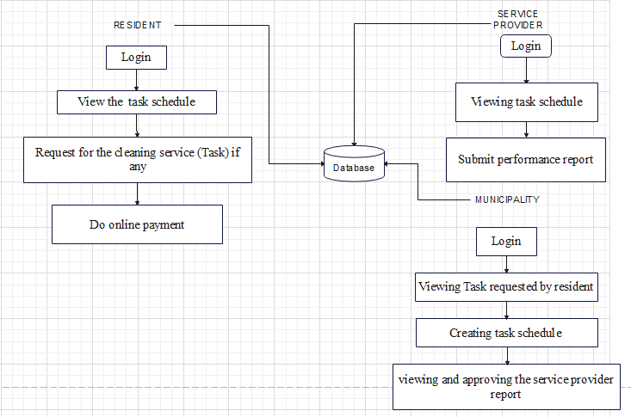
Proposed system

Slide 16
RELATED WORK
MUNICIPAL CLEANING SERVICE
Municipalities perform cleaning services in cities through a combination of in-house staff and contractors. The specific process for performing cleaning services may vary from municipality to municipality, but for ILALA municipality a general outline of the process is as follows:
Planning: The municipality identifies the areas in the city that require cleaning, such as public parks, sidewalks, and streets. They also determine the resources required to perform the cleaning, including staffing, equipment, and supplies.
Scheduling: The municipality schedules the cleaning services based on the availability of the resources and the priority of the cleaning needs. The scheduling information is communicated to the cleaning crews and contractors, who are responsible for performing the cleaning services.

Slide 17
RELATED WORK
MUNICIPAL CLEANING SERVICE
Dispatch: The cleaning crews and contractors are dispatched to the specified locations on the scheduled date and time to perform the cleaning services. The municipality provides the necessary equipment and supplies to the crews and contractors.
Cleaning: The cleaning crews and contractors perform the cleaning services, such as sweeping, power washing, and litter pick-up, in accordance with the municipality's guidelines and standards.
Inspection: The municipality inspects the cleaning services to ensure that they meet the required standards and quality. If necessary, additional cleaning services may be performed to correct any issues.
Reporting: The municipality tracks and reports on the cleaning services performed, including the type of service, location, and cost. The information is used to evaluate the performance of the cleaning services and make decisions on how to improve the service delivery.

Slide 18
PROJECT GAP
The main challenge is delaying of cleaning services to people from the cleaning service providers, presence of informal payments to resident from service provider and poor oversee of service provider’s performance by municipality.
From different reviews the problem can be solved by integrate the system with online payment and allow municipality to oversee the performance of the service provider by digitally schedule tasks and inspect their performance reports.

Slide 19
METHODOLOGY
The iterative model is a type of software development life cycle model that focuses on an initial, basic implementation that gradually adds more complexity and broader feature set until the final system is complete.
Iterative development is method of breaking down the software development of a massive program into smaller components.

Slide 20
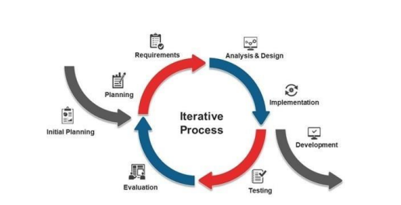
Iterative Methodology

Slide 21
WHY ITERATIVE MODEL METHODOLOGY?
Teams can quickly adapt to requirements changes without negatively impacting the release dates.
Greater customer satisfaction.
This model is suitable for identifying risks associated with the requirements early and mitigating them.

Slide 22
Data collection
Data were collected from Residents and from ILALA municipality by using various data collection tools which are: -
Interviews :Questions were prepared and asked to some of municipality officers and other community stakeholders like” mwenyekiti” based on how municipality manage and organizing environment cleaning services in general.
Questionnaire :Google forms were created and supplied to users via a link

Slide 23
Data collection
From the Questionnaire, Residents are facing challenges on how environment cleaning services are provided to their areas, which are:
Delaying of cleaning services from the cleaning service providers.
The cleaning services are not sufficiently and efficiently provided.
Additional of informal costs.

Slide 24
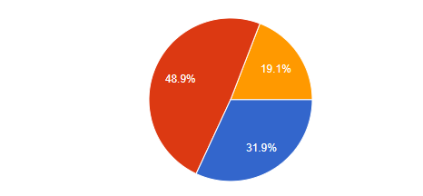
A chart that shows the service provider’s punctuality on providing cleaning services
Where by: -
Blue represents cleaners were on time
Red represents cleaners were not on time
Yellow represents unknown variables

Slide 25
Data collection
From the interview, there are various challenges encounter municipality on the issue of providing cleaning services, this include: -
Poor management of service provider’s performance and punctuality when delivering cleaning services to people.
Delaying on receiving of cleaning service tasks from different areas.
Low capital to manage and monitoring cleaning services over the entire municipality.

Slide 26
Requirement and system analysis
Functional Requirements and Non-functional requirements

Slide 27
Functional requirements
S/N | FUNCTIONAL DISCRIPTION |  | CATEGORY
F1 | Management of user
1.1 | System should allow Resident to log in by entering their physical address and password. | Evident
1.2 | System should allow Service provider to register and log in. | Evident
1.3 | System should allow municipality to login | Evident
1.4 | The municipality should be able to manage service provider, including adding, editing, and deleting service provider as needed. | Evident

Slide 28
Functional requirements
S/N | FUNCTIONAL DISCRIPTION |  | CATEGORY
F2 | Management of Task
2.1 | System should allow Resident to request for the cleaning service (task) | Evident
2.2 | The municipality should be able to create and manage tasks, including assigning tasks to service providers and setting priorities. | Evident
2.2 | Service providers should be able to view their assigned tasks and update their status. | Evident
2.3 | Residents should be able to view the status of their tasks and provide feedback. | Evident

Slide 29
Functional requirements
S/N | FUNCTIONAL DISCRIPTION |  | CATEGORY
F3 | Management of payments
3.1 | Residents should be able to make payments online | Evident
3.2 | System should arrange payment to Resident according to cleaning service description | Hidden
3.3 | System should store transaction details | Hidden

Slide 30
Functional requirements
S/N | FUNCTIONAL DISCRIPTION |  | CATEGORY
F4 | Management of report
4.1 | Service providers should be able to submit performance reports, including information on the tasks they completed and the resources used. | Evident
4.2 | The municipality should be able to view and review reports, including providing feedback and approving reports. | Evident

Slide 31
Functional requirements
S/N | FUNCTIONAL DISCRIPTION |  | CATEGORY
F5 | Management of schedule
5.1 | The municipality should be able to viewS and manage schedules, including Requested task for resident. | Evident
5.2 | Service providers and resident should be able to Upload and view their schedules and receive notifications of any changes or updates respectively. | Evident

Slide 32
Non-functional requirement
Non-Functional Requirements | Description
Performance | The system should be able to handle a large number of users and tasks and provide fast and reliable performance.
Security | The system should be secure, protecting sensitive information such payment information. It should enforce access controls and authenticate users.
Usability | The system I should be accessible and usable on smartphones and related devices.
Maintainability | The system should be easy to maintain, with clear documentation and well-defined processes for making updates and fixing bugs.
Compatibility | The system should be compatible with a range of operating systems and hardware, allowing it to be used by a wide variety of users.

Slide 33
Project scenario
The municipality uses the system to create the task schedule for cleaning services.
The schedule is created based on the availability of service providers and requests received from residents and from municipality.
A resident is log in to the system through a mobile app by entering the physical address and the password.
Then resident can view the schedule and request for the cleaning services (tasks) if any.

Slide 34
Project scenario
The service provider will view the task schedule and perform the scheduled cleaning service tasks as planned.
After the service provider completes the cleaning service for a particular resident or area, the resident will have to do online payment through by entering the physical address and the System be able to generate the control number for the specific resident and rate the service.
After resident paid online, the service provider will have to submit their performance report for the particular resident or area, and municipality will have to view and approve the report.

Slide 35
Actors of the system
In this system, there are several actors that play a role in the process. These actors include: -
Resident
Service provider
municipality

Slide 36
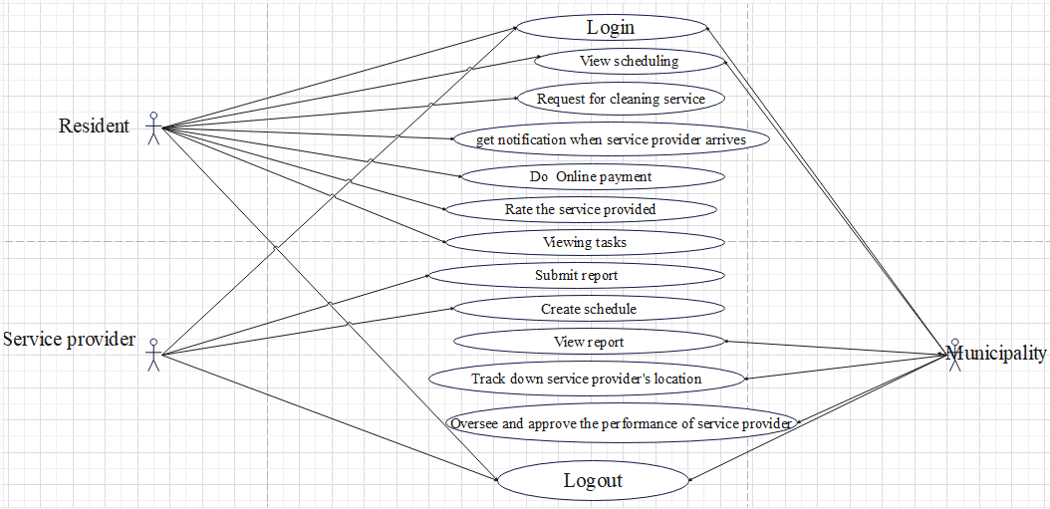
Use case diagram

Slide 37
Use case description
USECASE NUMBER | 1
Use case name | Do online payment on the cleaning service provided
Actor | User
Description | The user will have to do online payment as the way to pay for cleaning service provided, so as to reduce presence of informal payments.
Pre-condition | The user has to login to the system.
Post-condition | After payment, user will have to rate for the service provided.
Normal cause | System will have to arrange for the payment of the specific cleaning service provided. User will make online payment Payment details should be stored

Slide 38
Use case description
USECASE NUMBER | 2
Use case name | Submitting the cleaning service report of each resident.
Actor | Service provider
Description | Service providers will have to submit report of each resident on the cleaning tasks they have completed, including any issues that need to be addressed.
Pre-condition | The service provider must have access to the municipal cleaning service system and have a valid login.
Post-condition | The service provider will to have successfully submitted the report for the cleaning tasks. The report will be securely recorded in the system. The municipality will have access to the report and will be able to review the details of the cleaning tasks
Normal cause | The service provider will have to complete the cleaning service (task) required for specific resident or area as scheduled. Service provider will have to submit the report. The report details should be stored.

Slide 39
Use case description
USECASE NUMBER | 3
Use case name | Oversee the performance of the service provider
Actor | Municipality
Description | The municipality will have to monitor the performance of service provider including the quality of the service provided and their punctuality.
Pre-condition | The municipality has to log in. The municipality has to view the tasks requested by residents. The municipality will have to create the task schedule for the service providers and their specific areas to work on.
Post-condition | The municipality will have to view the report submitted by the service provider.
Normal cause | The municipality will have to view the tasks requested by resident. The municipality will have to create the task schedule for service providers. The municipality will have to view the report submitted by service provider.

Slide 40
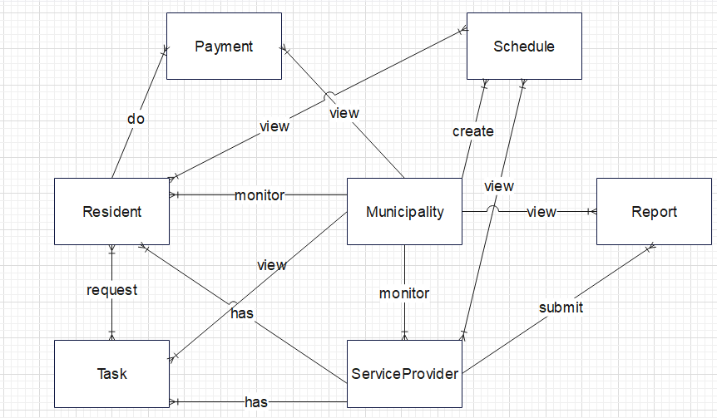
Database design-ERD

Slide 41
Database design-Relations from ERD
Resident (ResidentId, Name, PhysicalAddress, PhoneNumber, Emailing, PaymentInformation, MunicipalityId, ServiceProvider)
Municipality (MunicipalityId, MunicipalityName, PhoneNumber, Emailing)
ServiceProvider (ServiceProviderId, Name, PhoneNumber, Email, Specialty, Availability, MunicipalityId)
Task (TaskId, TypeTask, Location, Priority, Status, DueDate, ServiceProviderAssigned, MunicipalityId, ServiceProvider)
Schedule (ScheduleId, Date, Time, Service Provider assigned, TaskAssigned, Status, MunicipalityId)

Slide 42
Database design-Relations from ERD
Payment (PaymentId, ControlNumber, AmountDue, PaymentMethod, PaymentStatus, Date, TimeOfPayment, ResidentWhoMadeThePayment ResidentID, MunicipalityId)
Report (ReportId, DateAndTimeOfService, ServiceProviderWhoSubmittedReport, TaskCompleted, QualityOfServiceProvided, ResourcesUsed, Status, MunicipalityId, ServiceProvider)
RequestTask (TaskId, ResidentId)
ResidentViewScheduling (ResidentId, ScheduleId)
ServiceProviderViewScheduling (ServiceProviderId, ScheduleId)

Slide 43
IMPLEMENTATION

Slide 44
Technology Used
Flutter
Flutter is a mobile app development framework created by Google that allows developers to build natively compiled, fast and high-performance mobile applications for Android, iOS, and other platforms from a single codebase
Laravel
It is web application framework that Laravel can be used in combination with other tools and frameworks to create the backend APIs and services required by a mobile app.

Slide 45
Tools Used
Tools that have contributed to the implementation and visualization of this System are: -
Android Studio
GitHub
Visual studio code (VS code)
Post man

Slide 46
User Interfaces
Home page
It is typically the first page that users see when they visit an APP and it sets the tone for the overall user experience.
This user interface includes the name of the system, welcoming message, cleaning image and 3 cards hold Resident, Service provider and Municipality roles respectively.

Slide 47
User Interfaces
Login and Registering page
login page typically consists of a card having a form with fields for the user to enter their email address and their password.
The registration page typically consists of a form where the user enters their personal information, such as their name, email address, a password, Municipality name, phone number and Physical Address, so as they can sign up.

Slide 48
User Interfaces
Resident Page
Resident page includes information of accessing forms for requesting cleaning tasks or reporting cleanliness issues in task request Page.
It also includes features for payment in Payment Page and option of viewing schedule.

Slide 49
User Interfaces
Service provider Page
The page consists of a form where the service provider has to create report for the cleaning task performed and submit.
Also, service provider Page has option for the service provider to upload the schedule.

Slide 50
User Interfaces
Municipality Page
The page allows municipality to manage service provider (adding, deleting, and editing Service provider)
Viewing the schedule uploaded by the service provider
viewing pick up tasks submitted by resident
viewing report submitted by Service provider

Slide 51
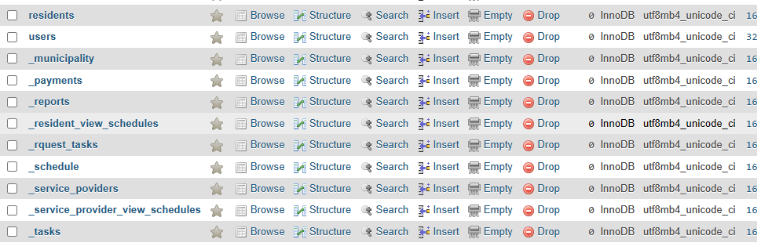
Database Implementation

Slide 52
BUDGET
s/n | CATEGORY | PARTICULAR | COST(Tsh) | TOTAL COST(Tsh)
1 | INTERNET | Internet Bundles | 3@50,000 | 150,000
2 | TRANSPORT | General transport | 50,000 | 50,000
2 | RESEARCH | Food Stationaries | 2@50,000 | 100,000
3 | HOSTING | Server space | 20,000 | 20,000
4 | PILOTING | Training users Training materials | @100,000 | 200,000
5 |  |  | TOTAL | 520,000

Slide 53
THANK YOU

